Slide 1
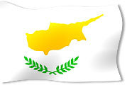
Cyprus-Κύπρος

Slide 2
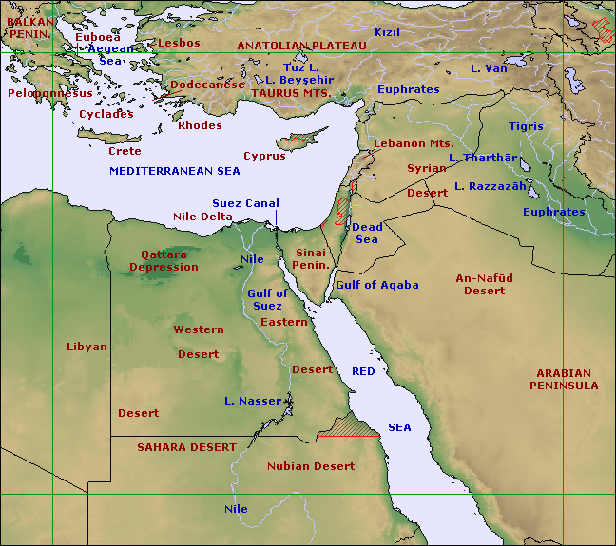

Slide 3
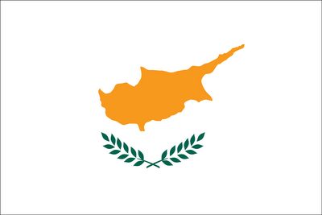
Cyprus’ flag is the only flag in the world that shows the map of the country.
The map on the flag is a copper-orange color, symbolizing the large deposits of copper ore on the island, from which it have received its name.
The two olive branches and the white color symbolize peace.
The blue and red color were forbidden because the blue color refers to Greece and the red to Turkey.
According to the Constitution of Cyprus, the Greek national anthem is used in the presence of the Greek Cypriot president (or other Greek Cypriot), and the Turkish national anthem is used in the presence of the Turkish Cypriot vice-president. Cyprus stopped using the Turkish national anthem, however, when Turkish Cypriots broke away from the Government in 1963. Hymn to Liberty was also the Greek Royal Anthem (since 1864).
The formal languages are Greek and Turkish.

Slide 4
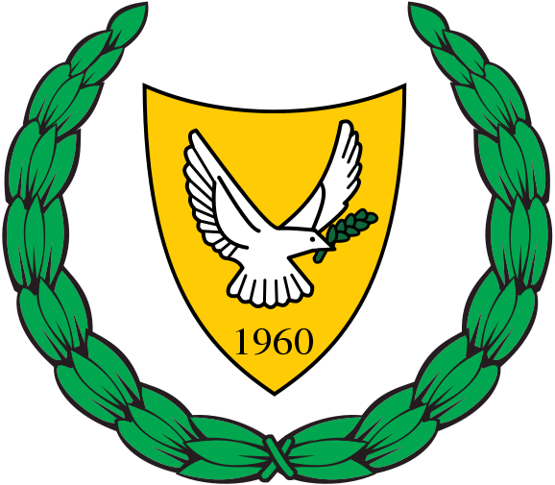
Τhe coat of arms of Cyprus depicts a dove carrying an olive branch (a well-known symbol of peace) over “1960”, the year of Cypriot independence from British rule. The background is a copper-yellow color; this symbolizes the large deposits of copper in Cyprus.

Slide 5
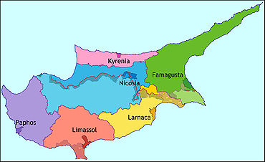
Cyprus is divided to 6 districts. Each one has the main town one of the 6 cities: Nicosia, Limassol, Famagusta, Larnaca, Paphos and Keryneia. Each district has 34 municipalities (10 of them are occupied) and many small villages.
But all the decisions are made by the governement.

Slide 6
Cyprus gained its independency in 1960, after 82 years of British rule and is a politically stable democracy with a system of government based on that of other Western Democracies where human rights, political pluralism and private property are safeguarded. Cyprus acceded to the European Union on the 1st of May 2004 and Eurozone at 1st of January 2008.
Head of State
Under the Constitution of 1960 the Head of State is the (Greek-Cypriot) President who is elected to office by absolute majority (of Greek -Cypriots votes) and, failing that, by simple majority in a second vote, in a universal and secret ballot every five years with provision for re-election. Cyprus has a multiparty system of democracy based on proportional representation. Also in the constitution of 1960 there is a Turkish-Cypriot vice-president who elected by the Turkish-Cypriots, but Turkish Cypriots broke away from the Government in 1963 TK until today.
Executive Body
Headed by and appointed by the President, the executive body of Cyprus is the Council of Ministers , whose members are responsible for the administration of the eleven ministries and the initiation of legislation.

Slide 7
Legislative Body
The House of Representatives is the legislative body of Cypriot government whose members are elected to office every five years by a system of proportional representation with candidates from the various existing political parties and social groups. (56 Greek-Cypriots and 24 Turkish -Cypriots).
Judiciary
The judiciary of Cyprus, which is independent from the other bodies of government, is modeled on the British system consisting of the Supreme Court, the Assize Courts and the District Courts.

Slide 8
Visit our facebook page to learn more about Cyprus!
“Cyprus. The island of beauty, love and culture”

