Slide 1
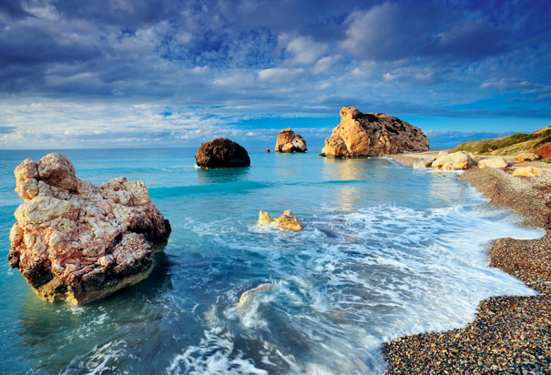
Welcome to Cyprus Culture Night
Καλώς ορίσατε!!!

Slide 2
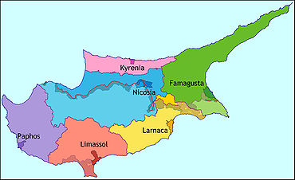
Let ‘s discover Cyprus!!!
Troodos

Slide 3
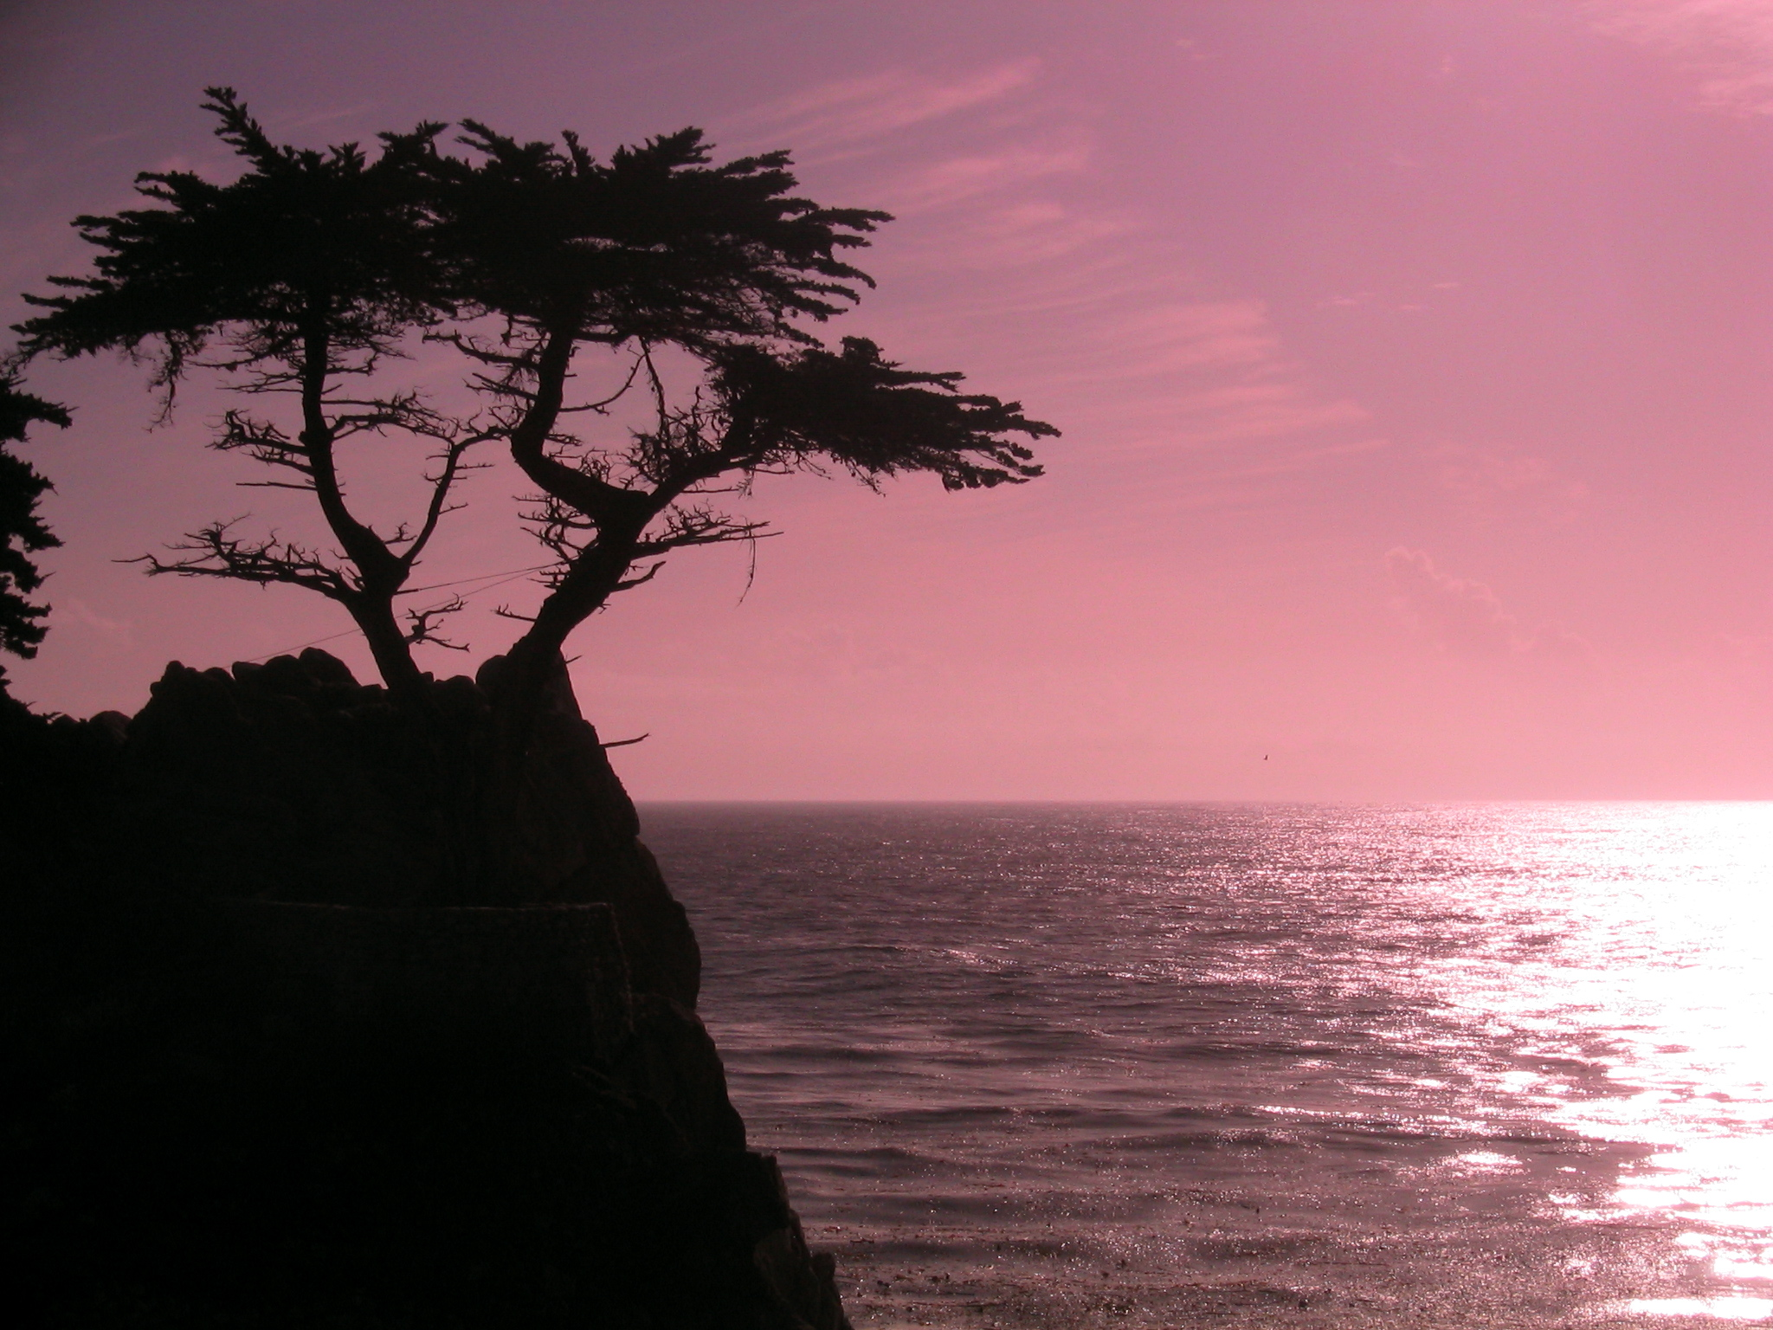
You are welcome to Cyprus!!!
«Kopiaste»

